Slide 1
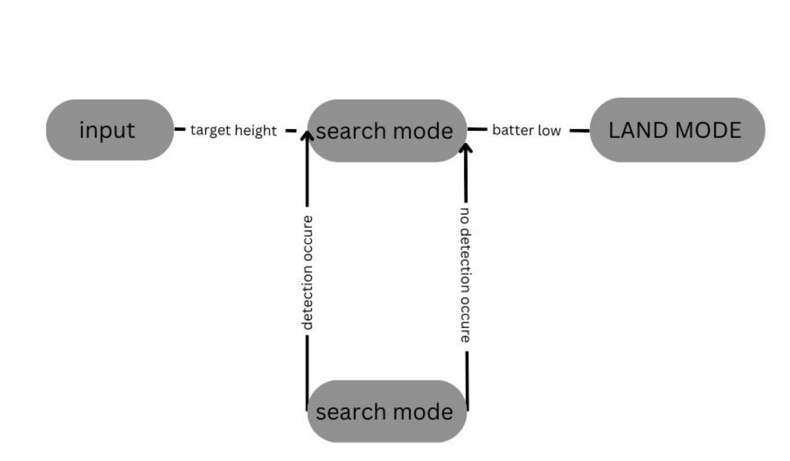
Idea/Approach Details
Describe your idea/Solution/Prototype here:
A drone-based software will be developed for surveillance in hydropower plant, monitoring work processes. (autonomous flight)
The drone will be embedded with an AI-based system, allowing for automatic charging and monitoring of the drone's performance.
The system will consist of two power stations with four ports, three main drones, and one or two backup drones. The drones will fly using a specific AI algorithm without interference, and the system will monitor temperature and battery levels.
After the drone takes off, it goes into search mode. If anything is detected, the drone will change itself to track mode. If nothing is detected, go back to search mode. When the battery reaches 20%, it automatically goes back to the charging station. For a wider area, we need to use four drones for surveillance; three drones are main, and another is backup.
. pitch, roll, and yaw will be used to locate the drone's path
CNN model used for deep learning framework and the drone can make its own path using some sensors like obstacles and cliff sensors.
Describe your Technology stack here:
Python
OpenCV
Jetson nano 4G
TF Luna
RGB camera (IMX219)
Tensor RT
CNN model
Mobil-Net
PID-Controller

Slide 2
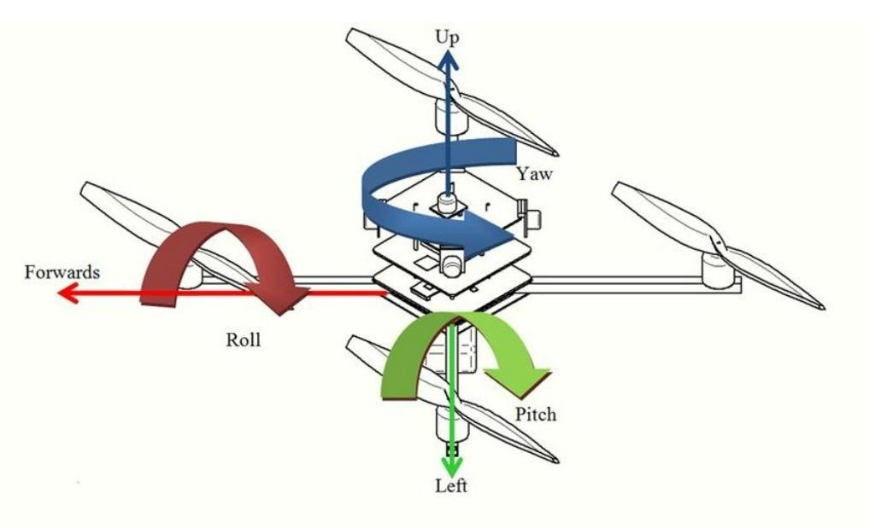
Idea/Approach Details
Describe your Use Cases here
This AI embedded system is very useful for drone surveillance because our drones fly continuously through the scanning area.
The cost of the project is equal to the normal cost of a drone.
Our drones have three states controlled by our AI application: search state, track state, and charging state
This is the next generation of drone security surveillance using AI.
The autonomous drones fly without help of a human , the maintenance charge will be less compare to labore cost.
Describe your Dependencies / Show stopper here
Our project is depends on the connectivity of the flight computer (jetson nano 4gb)
Climate change is the major problem for my project.
We are depending on corporate companies and the government for the city's security.

